Slide 1

Online Charity Management System
SAKHI FOUNDATION
DESIGNED BY ISMAIL KHAN

Slide 2

InDEX
Problem statement
Abstract
Introduction
Diagram
Future scope
Conclusion

Slide 3

Problem statement
Like the proverbial saying goes, Givers never Lack. Everyone wants to succeed in life, most individuals who wish to know more about the charity giving services or industry and benefits have to visit one of the charities organizations nearest to them or call on personal cell phone to donate funds or other items.
The main problems faced by charity organizations as identified are as follows:
Donors manually book appointments, and the owners of these firms write down same appointments in diary and forget most of them due to the high number of donors.
Overwhelming calls from donors who only wish to know more about the services and not necessarily donate items.
Although, most of these charity organizations have attracted a good number of donors and NGOs, they are yet to achieve the desired number of individuals/donors as originally planned.

Slide 4

ABSTRACT
The objectives are creating login and register page, donating to different element/categories, sending them confirmation once the donation form is filled with all the required details, and even letting them go through the funding and other donation system. The project’s design will then be constructed to visualize the attainment of these aims using Unified Modeling Language diagrams, Entity Relationship diagram, as well as Data Flow Diagram. In the implementation part of this project, the methodology was used for the development of this project. Also, visual studio Professional 2015 and IntelliJ Idea was used as an Integrated Development Environment (IDE), developed using Java programming language.

Slide 5
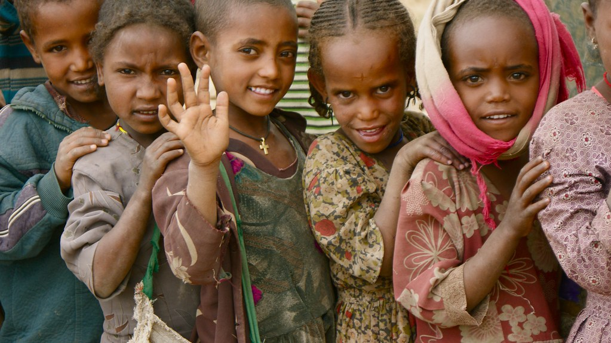
Introduction
The main aims and objectives of this project is to design a web-based app that helps the Donors and The NGO’s Ease their work.
Therefore, we propose to build a charity management system for the distribution of donations between charities, giving people the ability to notify about the surplus, and to inform about the poor who need help.
Development of income resources (donation).
Management and distribution of contributions to all the needy and low-income families.
Optimum provision and utilization of operational, physical, and human resources.
Organization and maintenance of facilities and family’s data to allow the ease of their access.
Speeding up the practical procedures.
Helping decision Makers in their strategic action plans

Slide 6
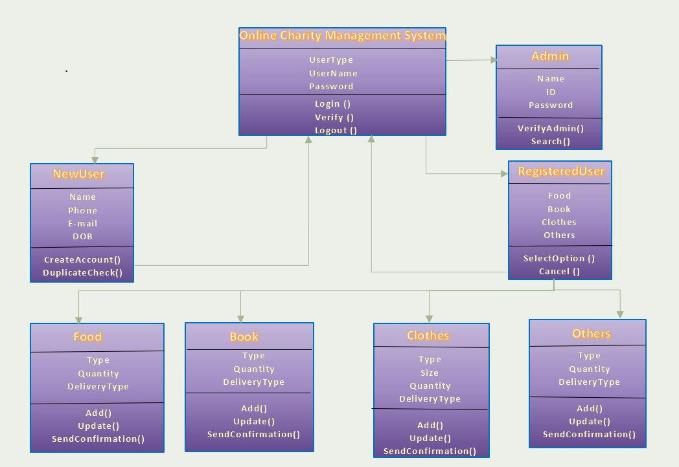
DIAGRAM

Slide 7
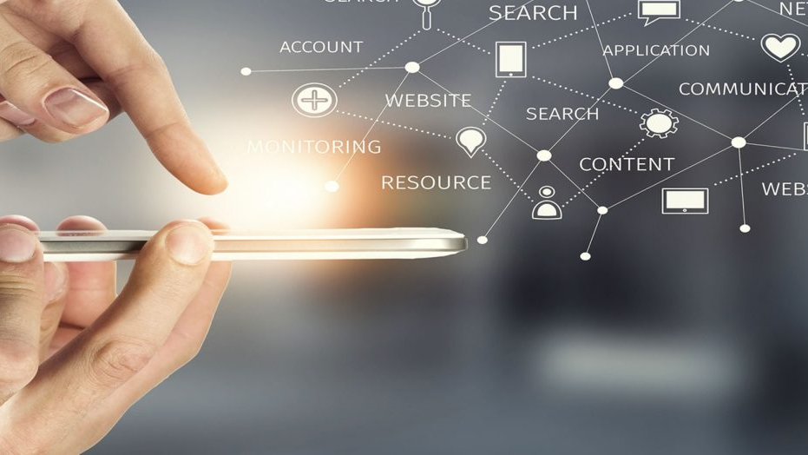
Future SCOPE
The following features listed below will be added to the application as enhancements in the future:
The use of google maps to pinpoint the user’s location instead of asking the user to enter their location.
The donor will be able to donate Funds using secure payment gateways
Deploying the database to Azure MySQL service.
The application will be able to have a virtual 24/7 chat service

Slide 8

Conclusion
For this application to be used effectively, I would strongly recommend that training be given to the admin, so he/she becomes acquainted with using the platform. Also, training should be given to donors on how to use the web application.
In conclusion, the quest to conquer the manual method of donating money has been turned into an online experience.

Slide 9

THANK you

